Slide 1
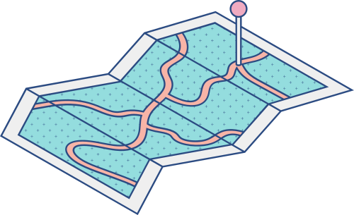





DIGITAL DIVIDE
IN COVID TIME
A tale of two states
HOANG THI THU TRANG
PHAM NGOC HIEU
NGUYEN THI HA TRINH

Slide 2


OUTLINE
Background Information
Case Study: California vs Illinois
Recommendations
Conclusion

Slide 3
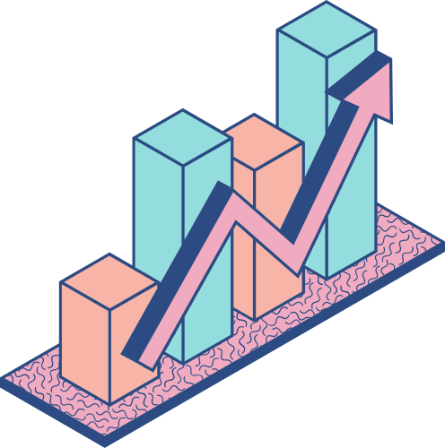
MAIN QUESTION
Whether the digital divide gap among students of different income groups in the US
narrowed down or widened during Covid-19 time?

Slide 4



PRE-COVID DIGITAL LEARNING GAP
“Homework gap"
Lack of learning devices
Lack of Internet access
Covid-induced school shutdown
Students cut-off school - supplied
devices and Internet

Slide 5
TARGET: LOWER – HIGHER INCOME STUDENTS
Between the beginning and end of 2020
Despite rapid growth in online engagement index
217.8 times
Online learning engagement gap between higher and lower income students increased by
2.86 times
Notes:
Engagement index: Total page-load events per one thousand students of a given product and on a given day
Lower-income students: *Students from school districts with >50% students receiving free/reduced lunches
Higher-income students: *Students from school districts with >50% students receiving free/reduced lunches

Slide 6


DATA OVERVIEW & APPROACH
Student engagement data
Collected through LearnPlatform Chrome Extension
112 school districts over 15 states
Data
Approach
Case study focusing on states

Slide 7

DATA LIMITATIONS
Lack of district-level data
Cannot merge with other data
Unrepresentative data
Small sample
Disproportionate sample
Unbalanced number of schools per states
Relatively high number of schools
Both higher- and lower-income schools

Slide 8
COVID-19 EXACERBATED ONLINE LEARNING ENGAGEMENT GAP
BETWEEN HIGHER & LOWER - INCOME STUDENTS OVER 2020
Almost every school closed
Spring break -> End of schoolyear -> Summer break
Engagement index gap fluctuated a lot during 2020 and ended up higher than at the beginning
Schools started closing down
Starting of 2020 – 2021 schoolyear

Slide 9
CALIFORNIA VS ILLINOIS: OPPOSITE TREND
IN ENGAGEMENT INDEX GAP DURING 2020 – 2021 SCHOOL YEAR
School closure announcement
Week

Slide 10
CALIFORNIA VS ILLINOIS: OPPOSITE TREND
IN ENGAGEMENT INDEX GAP DURING 2020 – 2021 SCHOOL YEAR
Week

Slide 11
GOOGLE PRODUCTS HAVE BIGGER ENGAGEMENT INDEX GAP
IN ILLINOIS THAN IN CALIFORNIA
Top 5 products with biggest engagement index gap
Illinois
California

Slide 12

SIMILAR SUPPORTING STRATEGIES
CAUSES
SOLUTIONS
Lack of learning devices
Provide laptops/tablets for lower-income students
Lack of Internet access
Provide Wifi hotspots
Supporting packages from Internet service providers

Slide 13
DIFFERENCE IN PROMPTNESS OF ACTIONS
2-week temporary shutdown announced
1-week shutdown extension
2-week shutdown extension
‘Remote learning plan’ ordered
ILLINOIS
Week 14
Week 12
Week 11
CALIFORNIA
90% schools self shutdown
All schools ordered closed
Schoolyear – end shutdown
Support package announced
Notes:
Anh Tiến (nhiều hơn)/Chinh: CHo cái timeline này cùng chung 1 slide với graph slide 8 (dùng effect nào đó để khi nhấn vào nó hiện ra)???
Trinh’s note: em đã bớt chữ slide này và chỉ để lại keywords. Mình có thể chỉnh animation/effect sao cho chữ nó xuất hiện theo từng cặp, nói tới đâu bấm cho hiện ra tới đó được không chị?

Slide 14

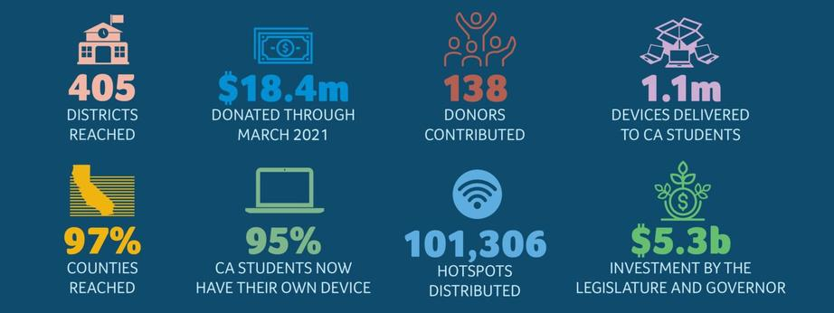
DIFFENCE IN SCALE OF ACTIONS
Illinois:
Initiatives mostly at local district/school levels
California:
State-wise initiatives - Bridging the Digital Divide Fund

Slide 15
DIFFERENCE IN ACTIONS YIELD DIFFERENT RESULTS
Device gap had closed up in both states
Internet gap still remained in Illinois

Slide 16
INTERNET AVAILABILITY NOT ENOUGH
TO CLOSE ONLINE LEARNING GAP
In Illinois, Internet availability gap declined
The engagement index gap surged
in academic year 2020-2021

Slide 17

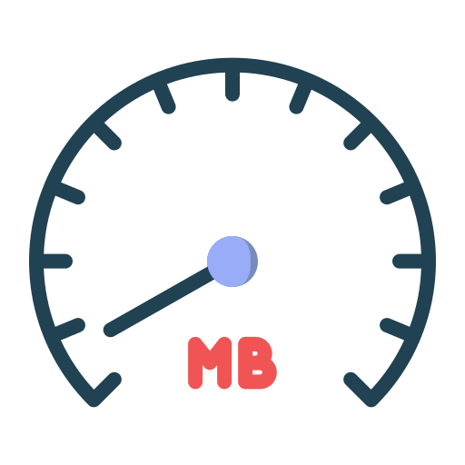

INTERNET QUALITY ALSO MATTERS
required for online learning
25 MBPs
Limits of supports from Internet providers
Application needed
Low speed
Location bound
Notes:
Phải thêm 1 yếu tố nữa là California rộng hơn Illinois, nên hotspot Cali cần có thì nhiều hơn Illinois?

Slide 18

INTERNET QUALITY: CALIFORNIA MORE SUCCESSFUL
required for online learning
25 MBPs
Free public wifi hotspots
Illinois:
- April 15, 200 wifi hotspots
California:
April 1: 100,000 free premium broadband Wifi hotspots across the state from Google
Notes:
Phải thêm 1 yếu tố nữa là California rộng hơn Illinois, nên hotspot Cali cần có thì nhiều hơn Illinois?

Slide 19
BROADBAND INTERNET - KEY TO CLOSE ONLINE ENGAGEMENT GAP
Illinois caught up with California in terms of device availability in households.
But still behind in terms of broadband/high speed internet coverage
Illinois’s increasing engagement index gap mainly attributed to
gap in broadband/ high-speed Internet access

Slide 20
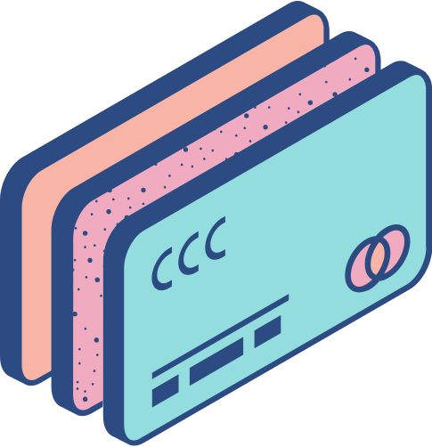
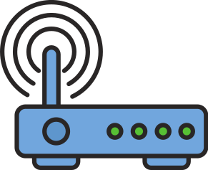


IMPORTANT FACTORS TO CLOSE THE DIGITAL LEARNING GAP
IN TIME OF CRISIS
From the stories of California & Illinois
Quality Internet
Responsiveness
Level of coordination
Notes:
ANH Tiến: Quality Internet là quan trọng nhất nên phải làm bật lên (có thể sắp xếp 3 factors theo level of importance)

Slide 21

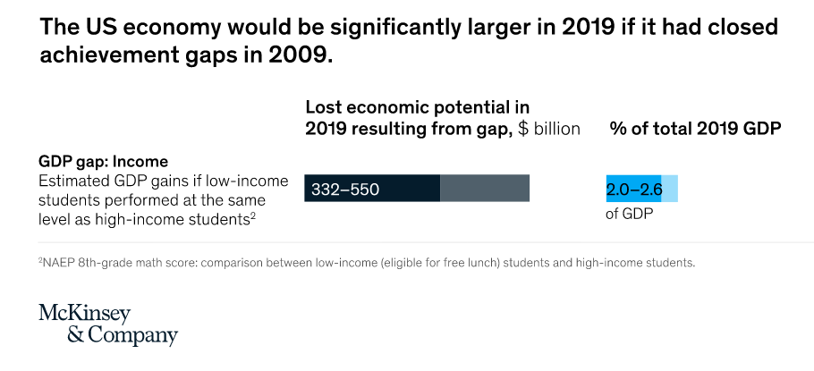

BROADBAND EQUITY IS NECESSARY
Broadband as for – profit products
Blockage of municipal broadband networks
Making broadband network a public goods rather private goods
Notes:
Slide nhiều chữ nên bớt lại để tập trung vào người nói

Slide 22

“Broadband access is the great equalizer, leveling the playing field so that every willing and able person, no matter their station in life, has access to the information and tools necessary to achieve the American Dream."
MICHAEL K.POWELL
FORMER CHAIRMAN OF THE FEDERAL COMMUNICATIONS COMMISSION OF THE UNITED STATES

Slide 23



Do you have any questions?
PHAM NGOC HIEU
hieu.n.pham1210@gmail.com
https://www.linkedin.com/in/hieu-pham-844196233/
HOANG THI THU TRANG
hoangthutrang.ftu@gmail.com
https://www.linkedin.com/in/trang-hoang-771b244a/
NGUYEN THI HA TRINH
natalietrinhnguyen@gmail.com
https://www.linkedin.com/in/natalietrinhnguyen/

